Slide 1
Template for Thrust or Project Meetings

Slide 2
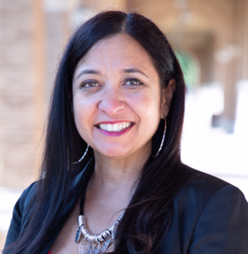
FUP#.Task# : Task Name
PI’s
Team Members
Include students, postdocs
If no member don’t have a picture please use, the following image, please do not expand or reduce the picture size. Include green border and circle shape (copy format of the example provided, crop image if needed)
Objective: A statement of the project goals.
Need: The project's role in support of the strategic plan; | Approach: Methodology used, Explain the relevance of your idea. What is innovative or unique about your project?
Benefit: What are the benefits gained by using your concept? | Key Results (Reporting Period):
Name
Title, Institution
Move the logo(s) to the institution section in the left, do not rezie
Testbed
Progress
TRL
UG
GS
PD
Institutions
Thrusts
Name
Title, Institution
1-9
#
#
#
T#, T#, T#

Slide 3
Summary of results and findings 1-3 pages (your Thrust leader may have specific limits for length):
In addition to the Project NABC Update Quad Chart (Slide #1), please complete additional 1-3 slides as project update with descriptions of achievements in the period. The project summary brief is expected to provide additional detail to the contained in the update quad chart, such as graphs, bullet points of findings or TEA analysis. May also include discussion points, such as the project’s role in support of the strategic plan or project’s diversity/inclusive engineering and workforce development initiatives.
Please also include a list of Publications, Patents, Presentations or Posters; if they are been submitted, accepted or presented in the period.
Please prioritize inclusion of illustrations and graphs; please do not include too much text in the slides
If you think extra slides are needed as supplementary information, for example slides with details of the methodologies used, this can be added but take in mind that there may be not be enough time for presenting them during the thrust or project meetings.
FUP#.Task: Results

Slide 4
Guidelines
For TRL level please use: TRL U.S. DEPARTMENT OF ENERGY Technology Readiness Assessment Guide
For technology applications projects for the Testbed Progress please contact Ozhan Gecgel ozhan.Gecgel@ttu.edu
UG Undergraduate Students
GS Graduate Students
PD Postdocs
Please contact Christian Alvarez-Pugliese if you have any question alv12192@ttu.edu

