Slide 1
CASFER Style Guide

Slide 2
CASFER Presentation Title Slide
(The title page should look like this, with the partnering logos below.)
Notes:
Good Morning everyone, and Welcome to the overview of the proposed National Science Foundation Engineering Research Center for Advancing Sustainable and Distributed Fertilizer Production, CASFER
My name is Gerri Botte, and I am CASFER’s Center Director.
CASFER is led by Texas Tech University, and four partner Universities:
Florida Agricultural and Mechanical University (FAM U)
Georgia Institute of Technology (GT)
Case Western Reserve University (CASE Western Reserve University)
and Massachusetts Institute of Technology (MIT)

Slide 3
Impact – Regular – 44 pt
First Statement, Arial Narrow Bold, Green – 28 pt – 32 pt
Arial Narrow Regular 24 pt – 28 pt, regular circle bullet point
Left Align, 1.0 line spacing, 0pt before and after.
Use this format for content heavy slides
Max 4-5 bullet points per slide
Graphic Font
Arial Narrow Regular
No smaller than 18 pt

Slide 4
Heading

Slide 5
Graphic Only Slides
Use this for Graphic-Only Slides

Slide 6
Color Values
Hex #248351
Hex #41929D
Hex #436661
Hex #9F6F47
Hex #000000

Slide 7
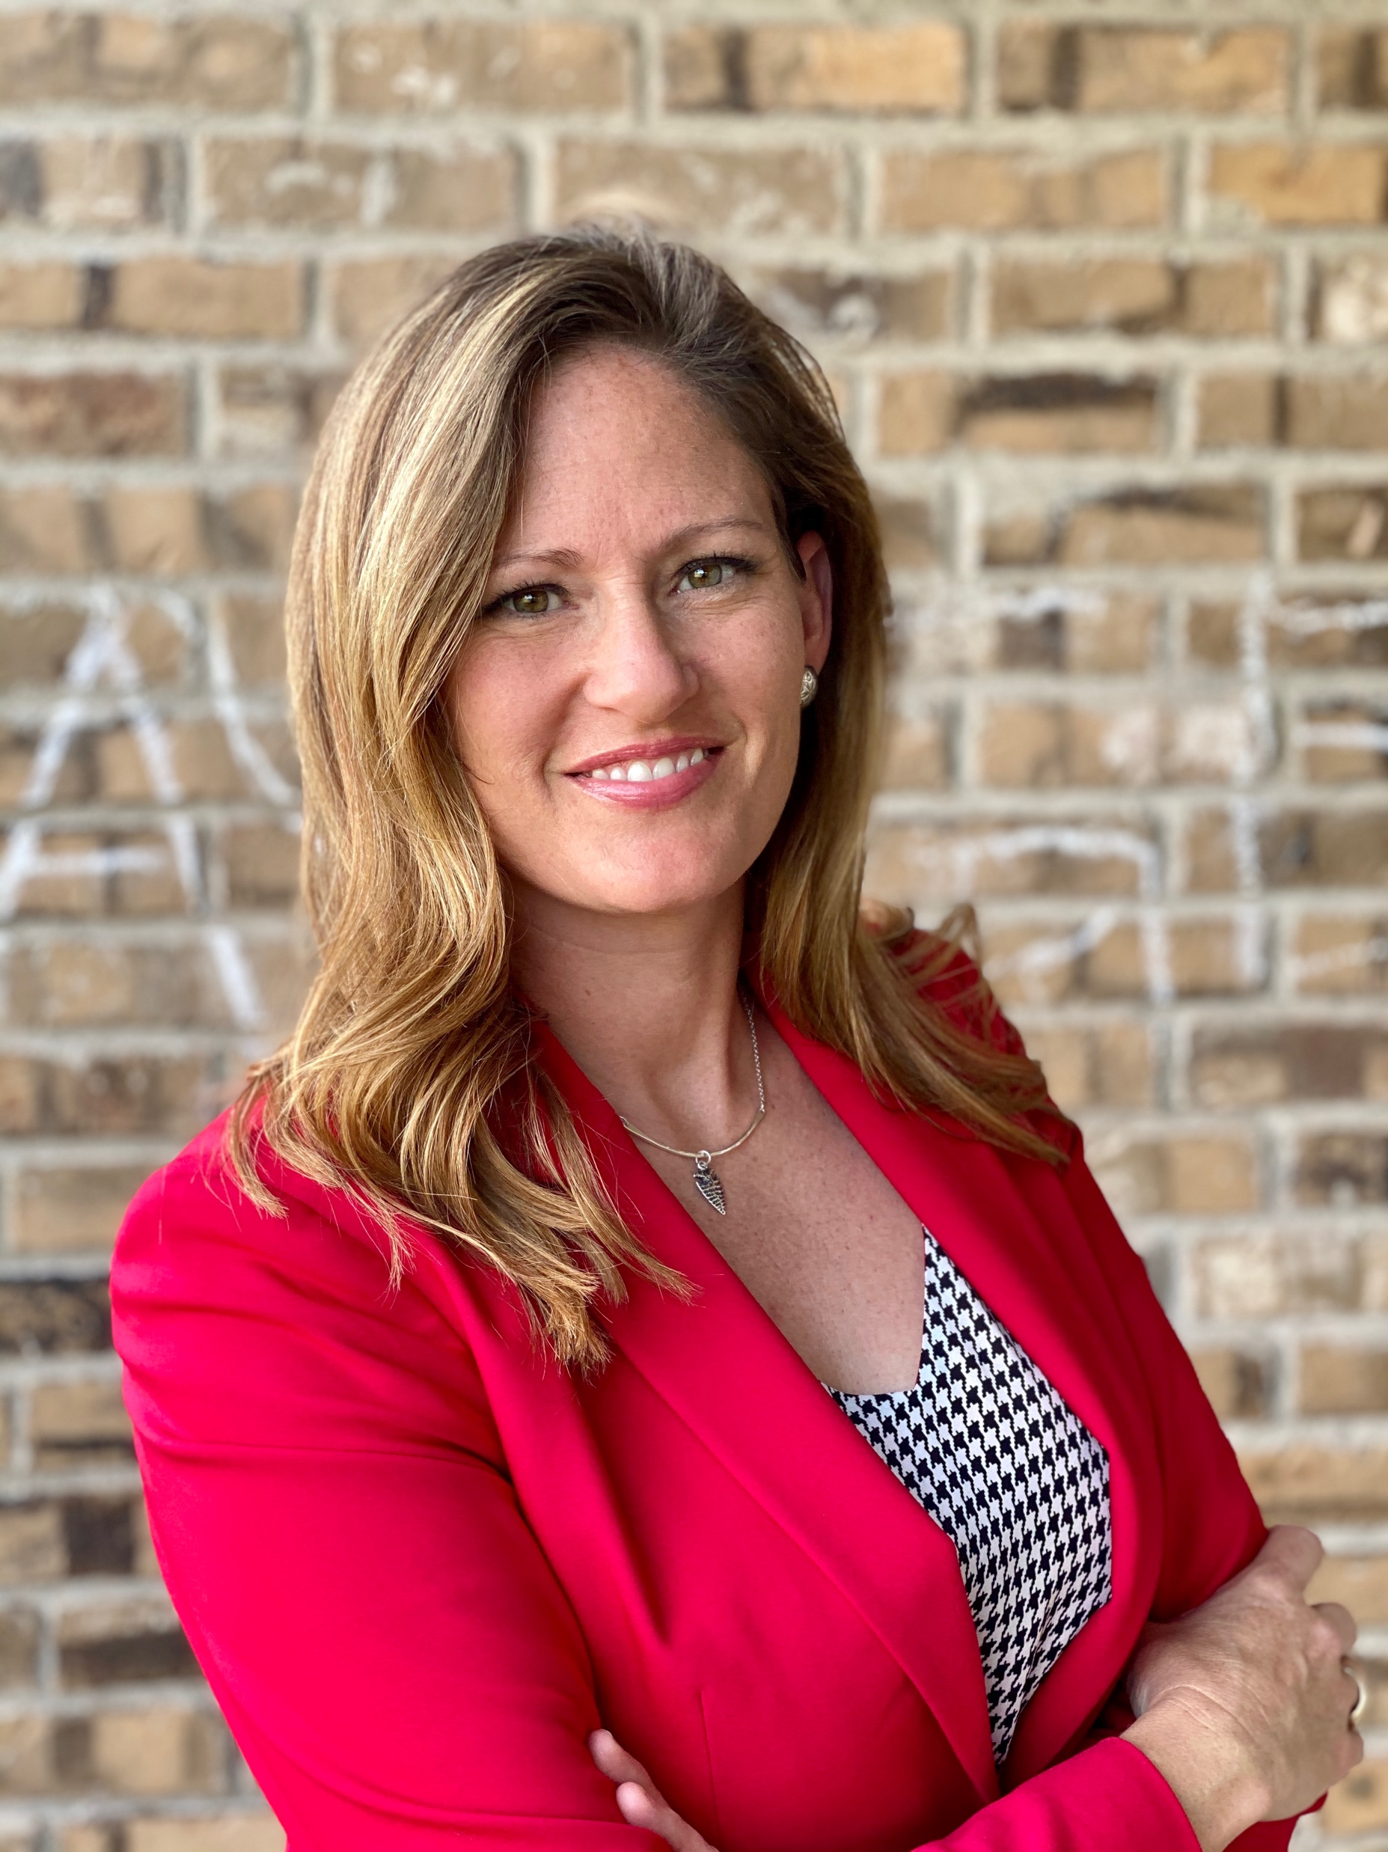
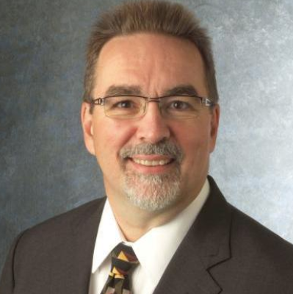
Leadership Photo Template
Roger H. French
Hesketh
Hardberger
Leader
Co-Leader
Co-Leader

Slide 8
Photo Guidelines
Large Leaders
3.3 x 3.3
White, 6 pt border

Slide 9
Photo Guidelines
Full Team (Gerri’s Overview)
2.3” x 2.3”
White, 6pt border
Small Participants
1.38” x 1.38”
White, 3pt border

