Slide 1
CASFER
Style Guide

Slide 2






CASFER Presentation Title Slide
(The title page should look like this, with the partnering logos below.)
Notes:
This format is based on NSF’s Perfect Pitch Competition for student presenters.

Slide 3
Impact – Regular – 44 pt
First Statement, Arial Narrow Bold, Green – 28 pt – 32 pt
Arial Narrow Regular 24 pt – 28 pt, regular circle bullet point
Left Align, 1.0 line spacing, 0pt before and after.
Use this format for content heavy slides
Max 4-5 bullet points per slide
Graphic Font
Arial Narrow Regular
No smaller than 18 pt

Slide 4
Heading

Slide 5
Graphic Only Slides
Use this for Graphic-Only Slides

Slide 6
Color Values
Hex #248351
Hex #41929D
Hex #436661
Hex #9F6F47
Hex #000000

Slide 7
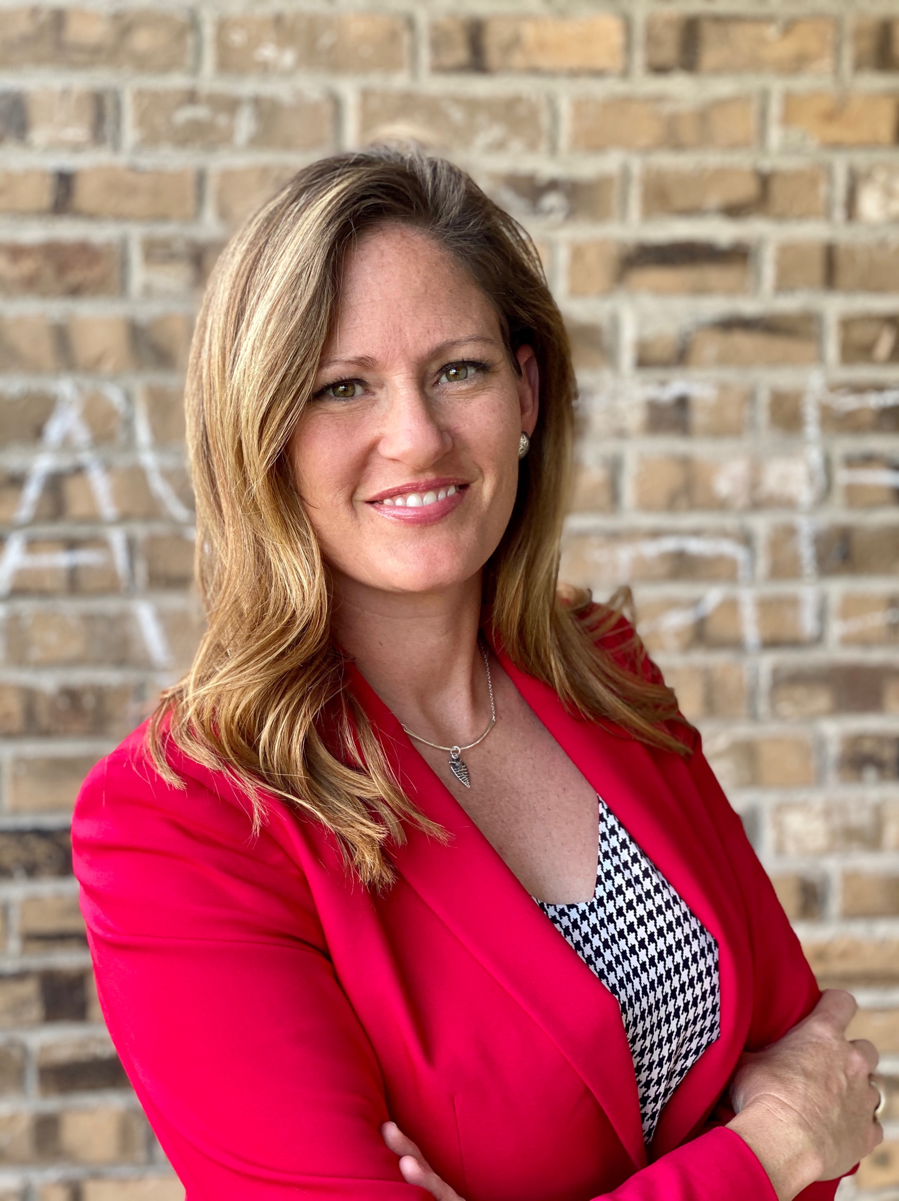
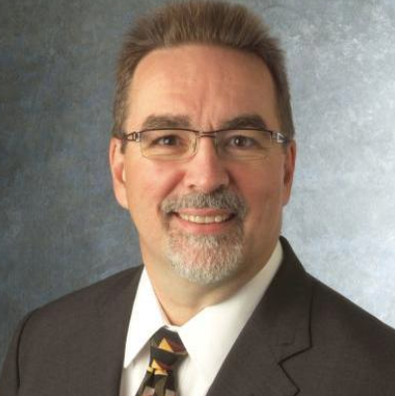
Leadership Photo Template
Roger H. French
Hesketh
Hardberger
Leader
Co-Leader
Co-Leader

Slide 8
Photo Guidelines
Large Leaders
3.3 x 3.3
White, 6 pt border

Slide 9

Photo Guidelines
Full Team (Gerri’s Overview)
2.3” x 2.3”
White, 6pt border
Small Participants
1.38” x 1.38”
White, 3pt border

